Slide 1

Divide by zero
Experian workshop – July 2021

Slide 2

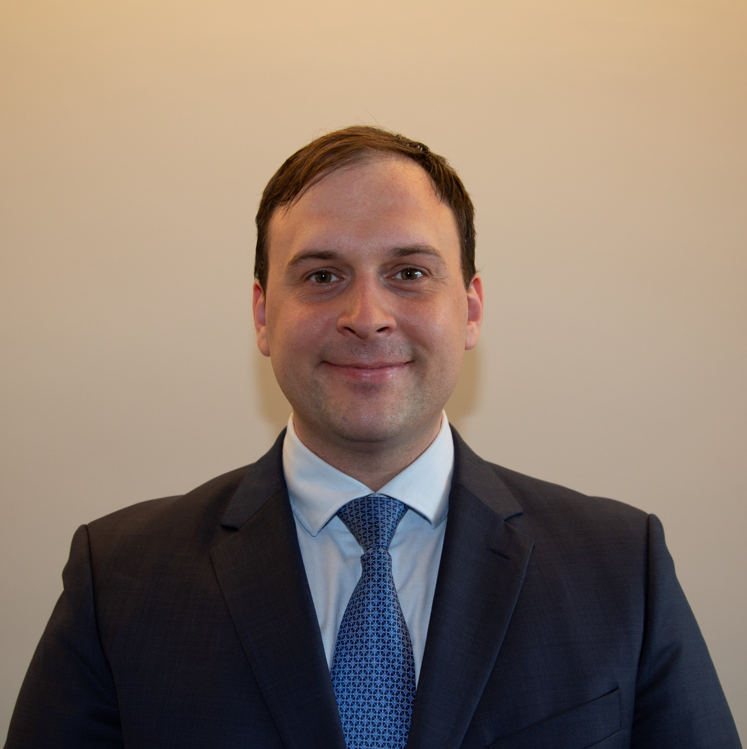

Meet our team
Kalin Kirilov
Team Mentor
Kristina Gercheva
Developer
Georgi Anastasov
Developer
Karolina Kirilova
Analyst
Boris Zabunov
Quality Assurance

Slide 3
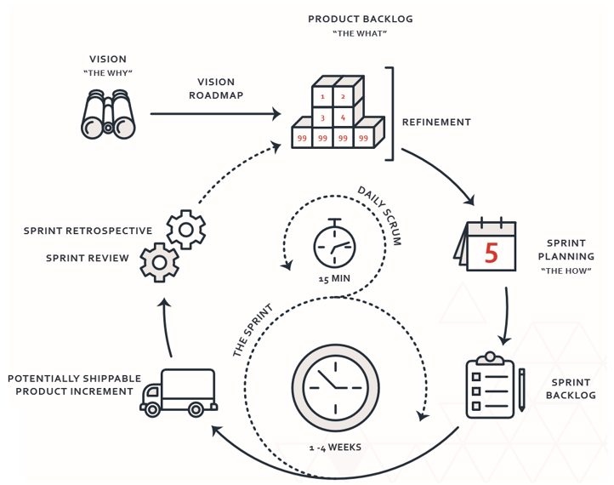
Our choice of methodology
Having in mind the complexity and the level of uncertainty we have chosen Scrum as our Software Development Methodology.
Although 4 weeks is a very short period of time, we had a taste of what Scrum is about and strived to follow the methodology as closely as we could.

Slide 4




Our toolset
We had the opportunity to utilize industry standard tools provided by Atlassian.
We replied on Jira to track all of our Epics, User Stories and Tasks. We utilized dashboards to track our progress and plan our weekly Sprints.
Using Confluence helped us establish a single point of truth when it comes to product requirements and methodology materials.
Bitbucket provided us with a place to collaborate on code, test and deployment.

Slide 5
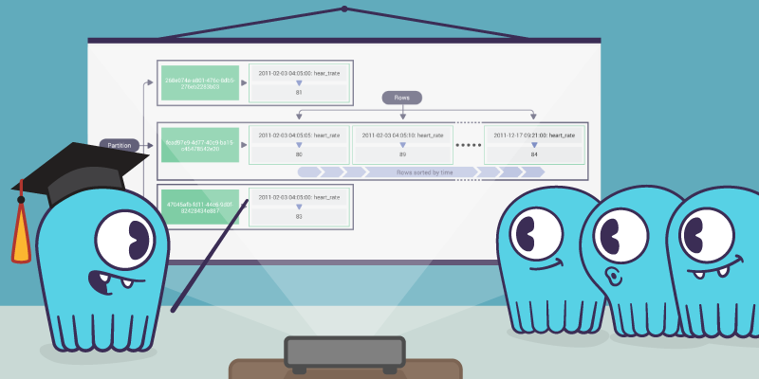
Our analytics model
The analytics model proved to be very challenging for us. Although we came up with one, it didn’t meet Experian’s requirements and high data quality standards.
Since we are committed to developing high quality products we felt that it will be better if we use a proven model and use the opportunity to learn from it.
We would like to use the opportunity to say a very special thank you to experience analysts for sharing their analytics model with us! This kind gesture helped us a lot and made our Experian journey even more exciting. It is a clear sign of sportsmanship, team spirit and a great example of a good practice.

Slide 6

Our Solution
Some of us tried really hard from the very beginning of the race, others didn't even make an effort at all. However, with a lot of work, learning and experimentation we managed to create a solution for this short period of time.
Our solution has a back-end and a front-end. In back-end we manage to process the given data in csv files and with the help of the model to calculate the credit score for each account, and then to save the results in a new file in the file system ready for research.
In front and end we managed to create two levels: the first level has home pages oriented to customers with information, loans, work, services for the company. The second has a panel with all the information needed for employees in the dashboard who can submit data files for processing or enter data for a client for manual processing.

Slide 7


Slide 8


Slide 9
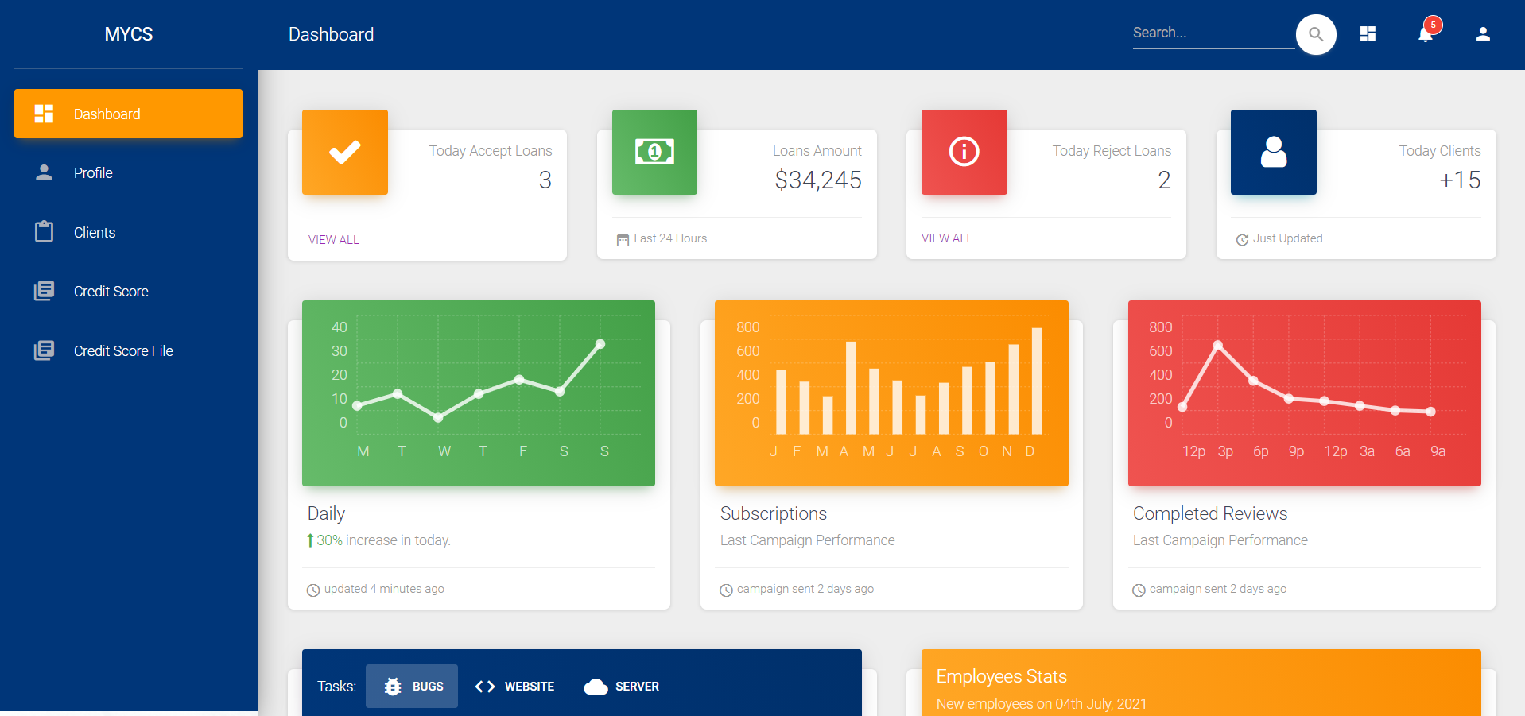

Slide 10
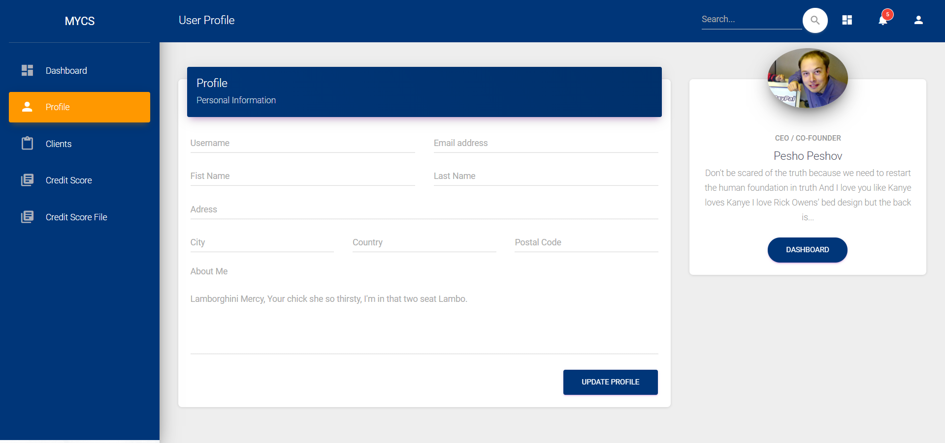

Slide 11
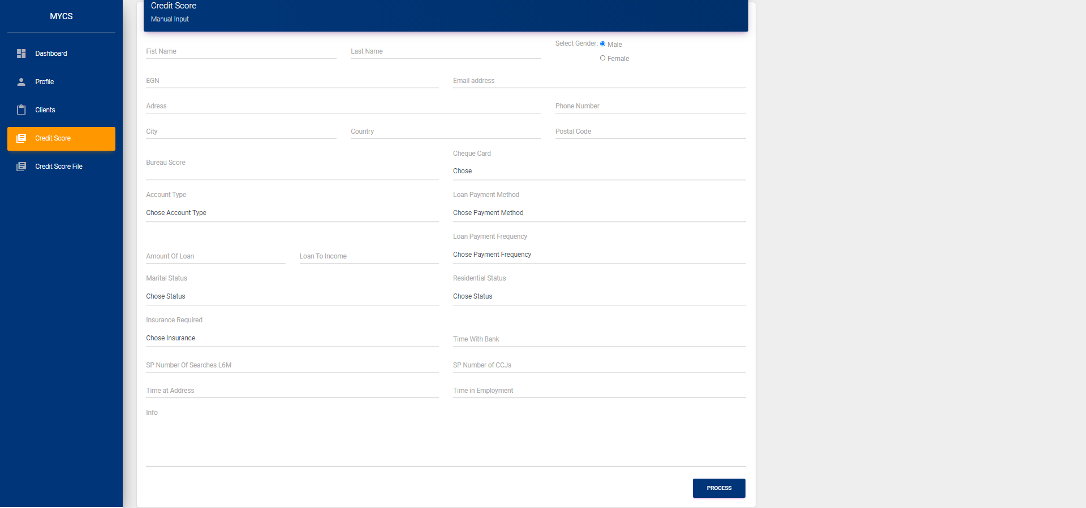

Slide 12
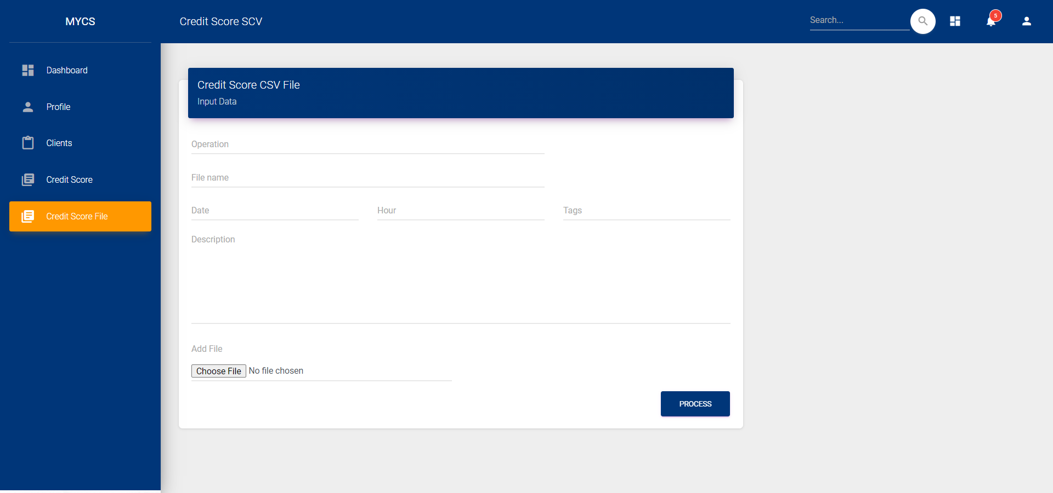

Slide 13
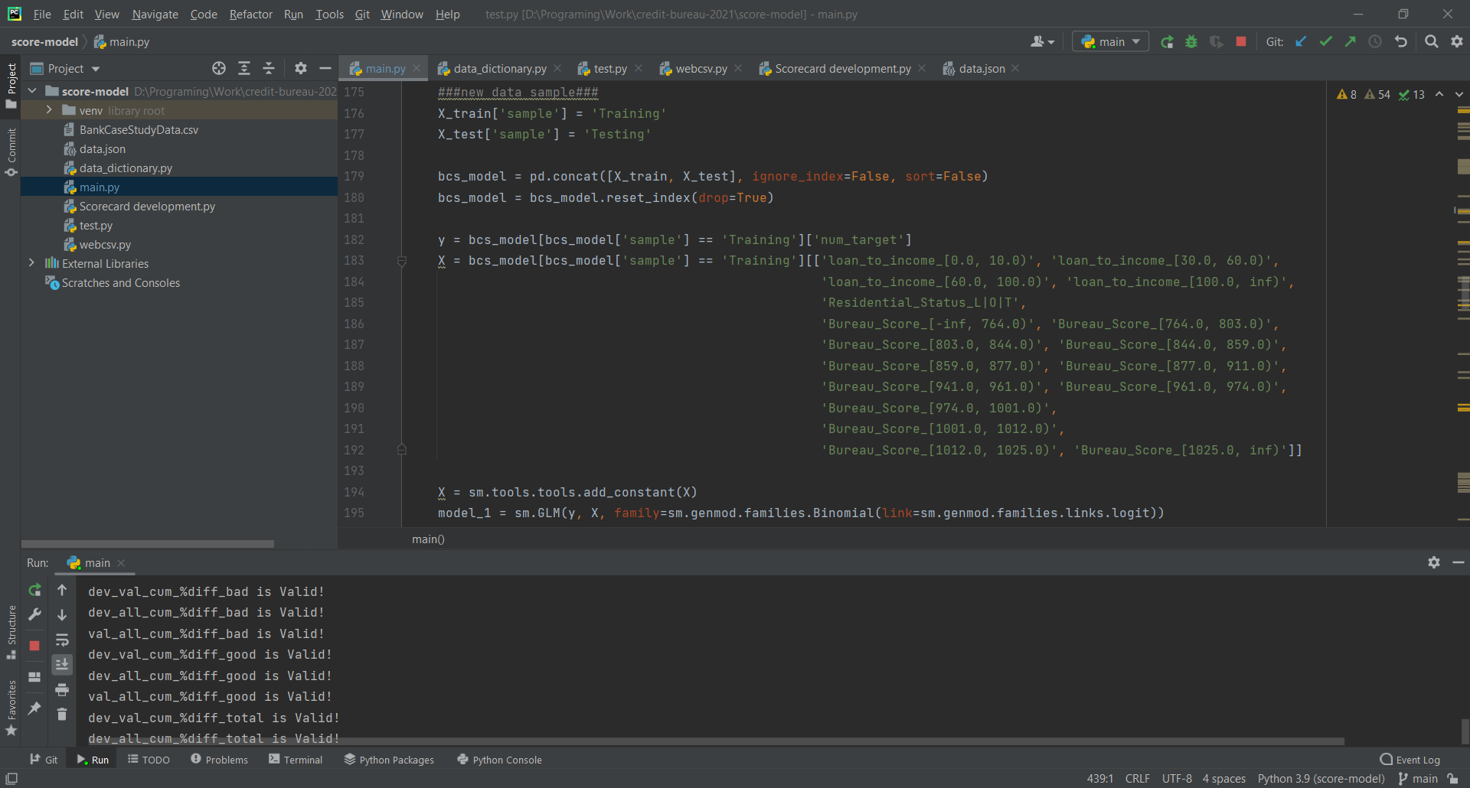

Slide 14
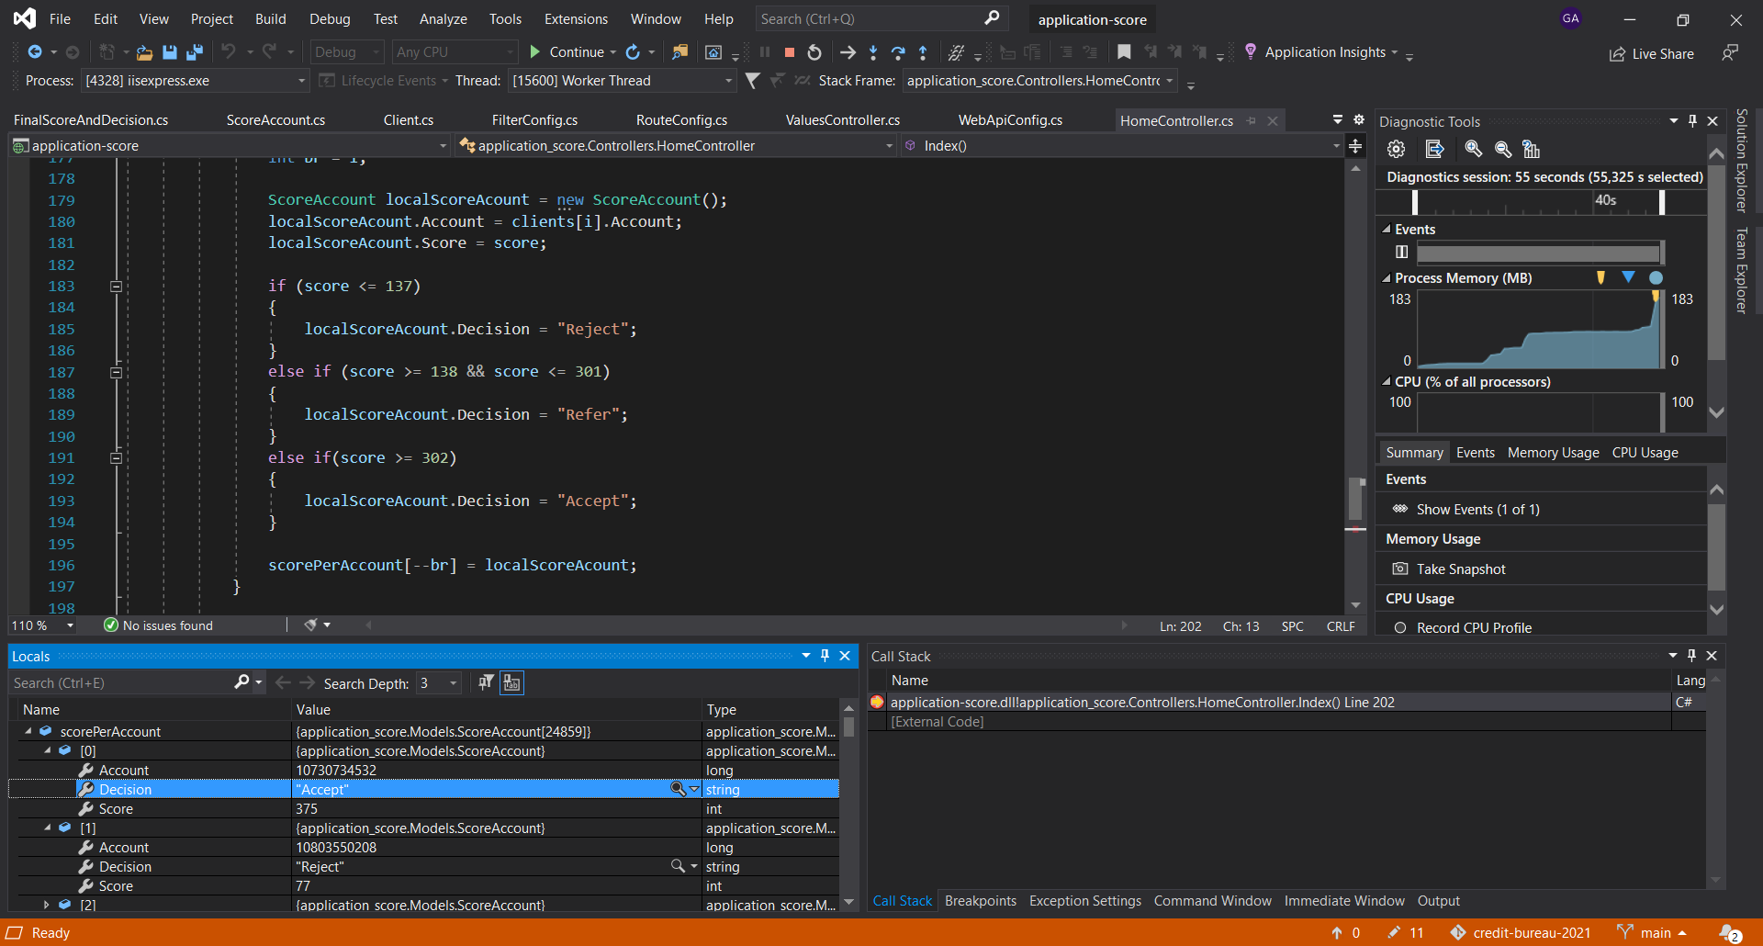

Slide 15


Slide 16
We thank Experian for giving us a field of expression for the opportunity to get closer to the real work process and for the experience gained.
Divide by zero
Experian workshop – July 2021

